Slide 1
Sort and Search
Algorithms
And their time complexities
Nicholas Pellegrino
Computer Science 131 - Discrete Mathematics

Slide 2
What are sort and search algorithms?
Algorithms are a set of steps and rules that always give a solution to a problem, given that a solution exists.
Examples of such can include an algorithm to solve a rubik’s cube, building furniture, solving a math problem, and even baking!
Search and sorting algorithms are just algorithms to sort a given list, and search a given list.
However, not all algorithms are created equal, and the time it takes to complete a sort or search algorithm differs greatly depending on the size of the list.

Slide 3
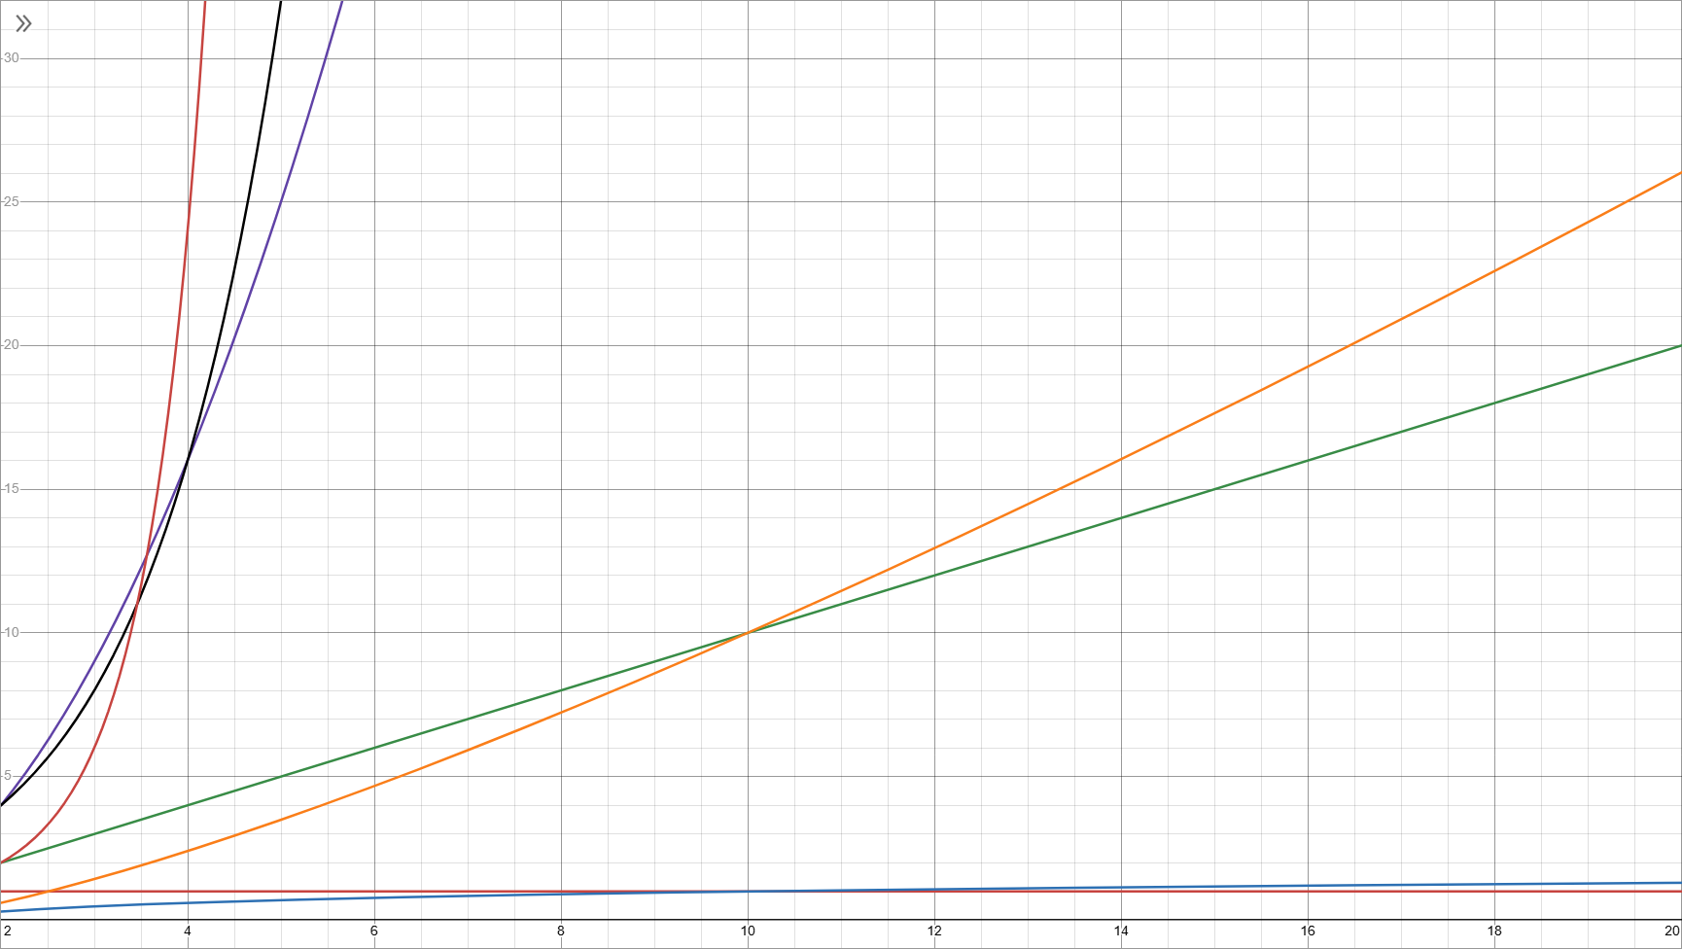
Time Complexity
Time complexity refers to the time it takes for an algorithm to complete with respect to the size of the list.
Time complexity is commonly in the form O(1), O(log(n)), O(n), O(nlog(n)), O(n²), O(2^{n}), and O(n!), where n is the size of the list.
O(1) - Algorithm takes the same amount of time, regardless of list size
O(n) - Algorithm takes time linearly proportional to the list size
O(n²) - Algorithm takes time proportional to the square of the list size
-O(2^{x})-
O(x!)
O(n²)
O(n*log(n))
O(n)
O(log(n))
O(1)

Slide 4
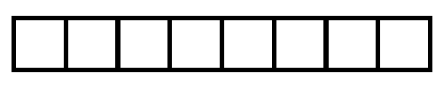
Linear Search Algorithm
procedure LinearSearch(x,a₁,a₂,...,a_{n} :integers)
{
for (i = 1; i <= n; i++)
{
if (a_{i} = x) then {return i}
}
return 0
}
A linear search algorithm is the simplest search algorithm to create, and requires no sorting before hand.
All it takes is going through each element in a list, and comparing it with the desired element. If the two match, then you have found the element you are searching for.
Its worst-case time complexity is O(n)
Found at i = 7
v
x=4
2
12
1
7
14
13
4
5
}
}
}
}
}
}
}

Slide 5
Binary Search Algorithm
procedure BinarySearch(x,a₁,a₂,...,a_{n} :integers)
{
left = 1
right = n
while (left < right)
{
mid = floor((left+right)/2)
If (x = a_{mid}) then {return mid}
if (x > a_{mid}) then {left = mid + 1}
else {right = mid}
}
if (a_{left} = x) then {return left}
return 0
}
A binary search algorithm is a simple search algorithm to create, but requires sorting the list before hand.
Two endpoints are created, and the algorithm repeats until the endpoints are on the same point. Each time the algorithm repeats, it creates a midpoint and checks if the desired number is less than or greater than the midpoint. Splitting the list into two each time until the desired number is found
Its worst-case time complexity is O(log(n))
x=4
1
2
4
5
7
12
13
14
left
mid
found
left
mid
right
right

Slide 6
Linear vs Binary
With just these two search algorithms, it is possible to see how their time complexity compares.
Linear Search is good for when the list is small, and does even better if the desired number is close to the start, however as the list grows, so does the possible time it will take to find the desired number. This is represented in its time complexity of O(n)
Binary Search is good for when the list is large, as each time it searches that list is cut in half, however it requires that the list is sorted, and can be outdone by linear if the number is near the beginning. This is represented in its time complexity of O(log(n))
Linear
Pros:
No sorting required
Very Simple to implement
Cons:
O(n) Time Complexity
Long lists directly increases the time it takes to complete the algorithm
Binary
Pros:
O(log(n)) Time Complexity
Long lists does not impact time taken to complete algorithm by a lot
Cons:
Requires sorting
Can be difficult to implement

Slide 7
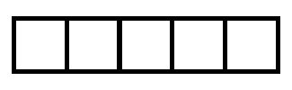
Selection Sort Algorithm
Selection Sort is a very simple sorting algorithm, where each loop involves taking the current element and swapping it with the smallest element.
Each loop the list gets smaller as the smallest element is placed at the beginning of the list, but still in front of any smaller elements.
It’s worst-case time complexity is O(n²)
procedure SelectionSort(a₁,a₂,...,a_{n} :integers)
{
for (i = 1; i < n-1; i++)
{
small = i
for (j = i; j < n; j++) {if (a_{j} < a_{small}) {small = j}}
temp = a_{i}
a_{i} = a_{small}
a_{small} = a_{i}
}
}
smallest
smallest
current
current
current
current
8
28
10
45
28
10
45
67
45
8
28
45
67

Slide 8
Bubble Sort Algorithm
Bubble Sort is a simple algorithm, where each loop involves looking at two adjacent numbers, and swapping them if necessary, and then moving down the list until you reach the end. Each pass ensures that at least one of the numbers is sorted.
Its worst-case time complexity is O(n²)
procedure BubbleSort(a₁,a₂,...,a_{n} : real numbers, n > 1)
{
for (i = 1; i < n, i++)
{
for (j = 1; j < n-i; j++)
if (a_{j} > a_{j+1}) then
{
temp = a_{j}
a_{j} = a_{j+1}
a_{j+1} = temp
}
}
}
8
28
10
28
45
10
10
8
28
10
45
8
67
45
8
8
67

Slide 9
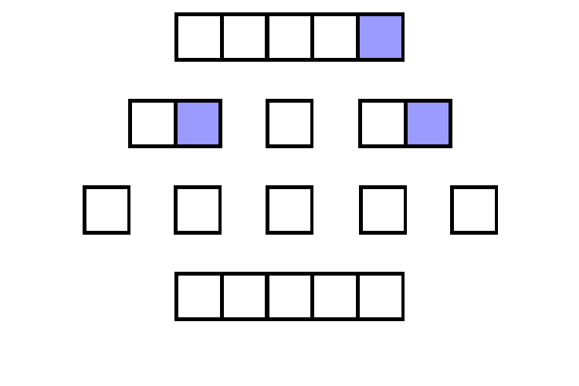
Quick Sort Algorithm
procedure sortPivot(low,high: integers a₁,a₂,...,a_{n} : real numbers)
{
pivot = a_{n}
changeIndex = low-1
for (int i = changeIndex; i < high; i++) {
if (a_{i} < pivot) then {
changeIndex++
a_{changeIndex} = temp
a_{changeIndex} = a_{i}
a_{i} = temp
}
}
a_{changeIndex+1} = temp
a_{changeIndex+1} = a_{high}
a_{high} = temp
return changeIndex+1
}
procedure QuickSort(low,high: integers a₁,a₂,...,a_{n} : real numbers)
{
if not (low < high) then {return}
pivotIndex = sortPivot(low,high: integers a₁,a₂,...,a_{n} : real numbers)
QuickSort(low,pivotIndex -1: integers a₁,a₂,...,a_{n} : real numbers)
QuickSort(pivotIndex +1,high: integers a₁,a₂,...,a_{n} : real numbers)
}
One of the more famous sorting algorithms, quick sort works by choosing a pivot and moving all numbers less than that pivot number behind it, and all numbers ahead of that pivot number ahead of it. This repeats recursively with different pivots until the list is sorted
While it’s worst-case is O(n²), it’s average case is O(nlog(n)), unlike the last two algorithms
45
10
67
8
28
<- Pivot
10
8
28
45
67
8
10
28
45
67
8
10
28
45
67

Slide 10
Which sorting algorithm to use?
Selection
Pros:
Simple to implement
Fewer swaps
Cons:
Worst-case O(n²) time complexity
Bubble
Pros:
Simple to implement
Good at checking if a loop is sorted
Cons:
Worst-case O(n²) time complexity
Quick
Pros:
Average-case O(n*log(n)) time complexity
Cons:
Worst-case O(n²) time complexity
Can be difficult to implement
Ultimately, it comes down to preference when it comes to selecting a sorting algorithm. Whether you feel like a faster one will be necessary, and how much time you want to spend writing the algorithm, the best to sorting algorithm may simply be the one you want to write.

Slide 11
Conclusion
There are many more sorting and searching algorithms, and the choice of which sorting and which searching algorithm to use is a choice that all programmers will have to make sometime in their career, and I hope that this presentation will give you some insight on how different algorithms are good for different things, whether that be time spent implementing or the speed at which the algorithm can complete its task.
Thank you for watching!

